Slide 1
Session 10 and 11

Slide 2
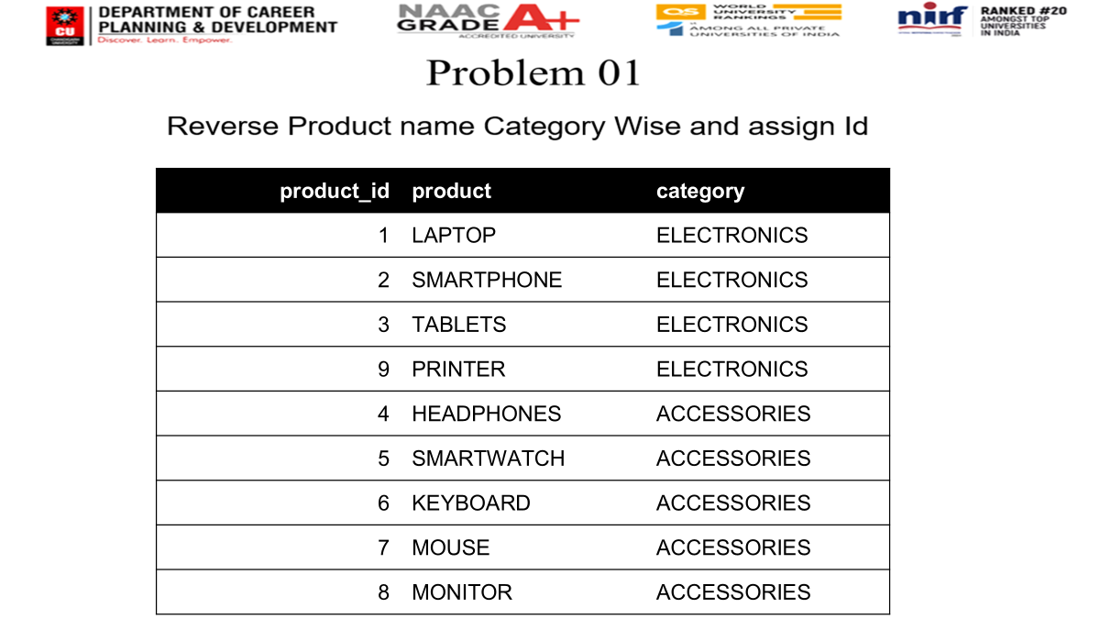

product_id | product | category
1 | LAPTOP | ELECTRONICS
2 | SMARTPHONE | ELECTRONICS
3 | TABLETS | ELECTRONICS
9 | PRINTER | ELECTRONICS
4 | HEADPHONES | ACCESSORIES
5 | SMARTWATCH | ACCESSORIES
6 | KEYBOARD | ACCESSORIES
7 | MOUSE | ACCESSORIES
8 | MONITOR | ACCESSORIES

Slide 3
Output:
product_id | product | category
1 | PRINTER | ELECTRONICS
2 | TABLETS | ELECTRONICS
3 | SMARTPHONE | ELECTRONICS
4 | LAPTOP | ELECTRONICS
1 | MONITOR | ACCESSORIES
2 | MOUSE | ACCESSORIES
3 | KEYBOARD | ACCESSORIES
4 | SMARTWATCH | ACCESSORIES
5 | HEADPHONES | ACCESSORIES

Slide 4
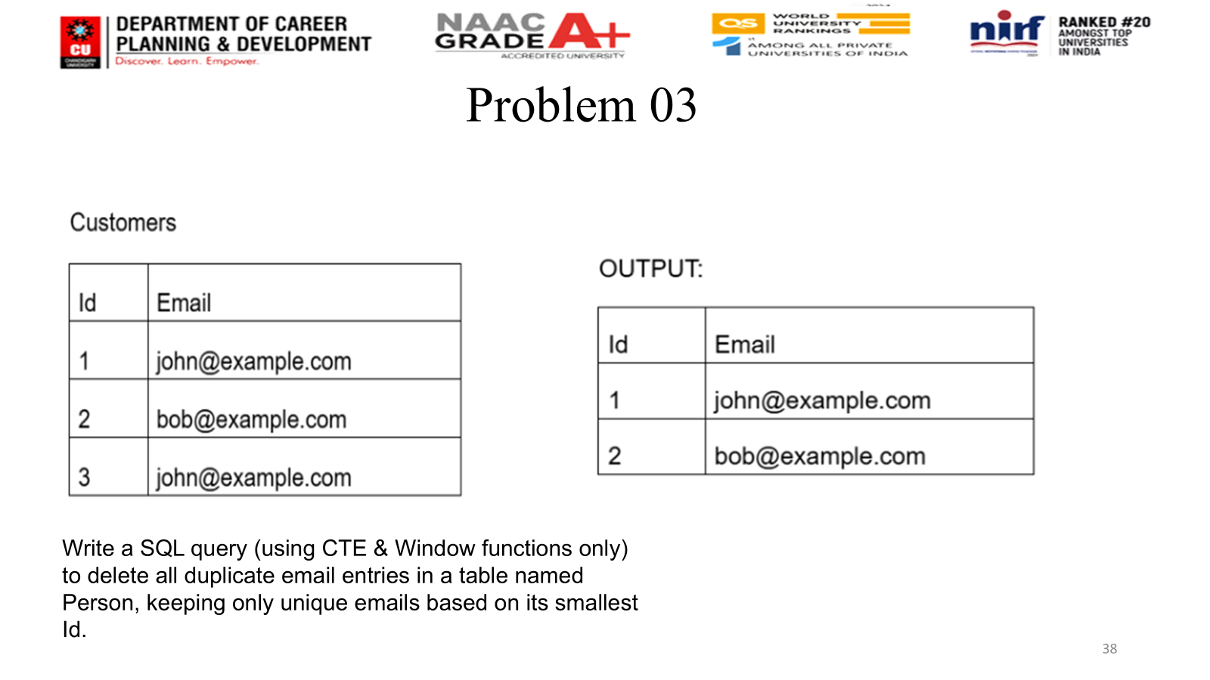

Session 14

Slide 5
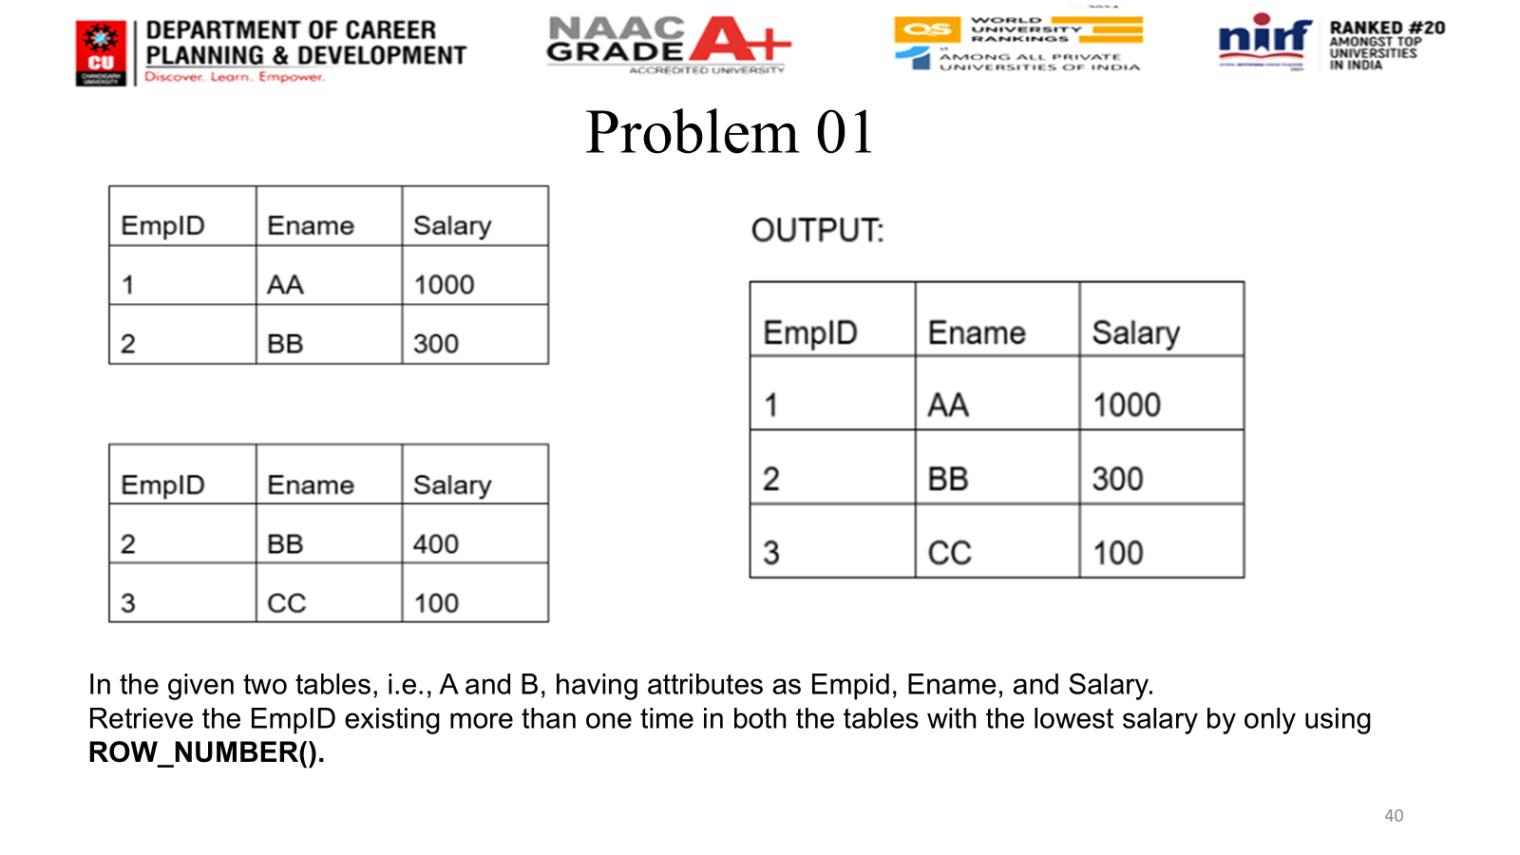

Session 14

